Slide 1

Exploratory Data Analysis (EDA) on Aspiring Mind Employment Outcome 2015 (AMEO) Dataset

Slide 2
About me
Hello, I'm Angad Gupta, currently pursuing a Bachelor of Technology (B-Tech) degree in Computer Engineering at RK University.
I want to learn data science because it's incredibly useful. It has a big impact on different industries and can help find important information in complicated data. Learning about data science is not just interesting, but it also gives me lots of chances to work in cool areas like artificial intelligence, machine learning, and predictive analytics.
While I haven't gained any professional work experience yet, I am eager to apply my theoretical knowledge in practical settings and contribute meaningfully to projects.
Below are my GitHub and LinkedIn profiles:
GitHub: https://github.com/Angad143
LinkedIn: https://www.linkedin.com/in/angadgupta143/

Slide 3
Objective of the Project:
The objective of this project is to perform Exploratory Data Analysis (EDA) on the AMEO dataset to gain insights into the employment outcomes of engineering graduates. Through data visualization and analysis, we aim to understand salary distributions, job titles, job locations, skill assessments, and other relevant factors impacting the employment landscape.
Summary of the Data:
The AMEO dataset contains 4000 rows and 40 columns, providing information on various aspects such as salary, job titles, job locations, and standardized skill scores. Initial exploration revealed the presence of duplicate values, missing data, and outliers, which necessitated data cleaning and preparation for analysis.
Key Questions:
What factors influence the salary outcomes for engineering graduates?
Are there any notable trends based on gender, specialization, or skills?

Slide 4
Exploratory Data Analysis:
Data Collection and Preparation
Source: The dataset was sourced from Aspiring Minds’ 2015 dataset on engineering
graduates' employment outcomes.
Data Cleaning:
Missing values and outliers were handled to ensure clean data for analysis.
Categorical columns were standardized (e.g., job titles, specializations).
Unwanted rows were dropped.
Steps:
Corrected inconsistent labels in categorical data.
Replaced placeholder values (like -1) with meaningful ones.
Handled outliers by analyzing using boxplots for numerical variables.

Slide 5
Exploratory Data Analysis:
Univariate Analysis
Goal: Understand the distribution of individual variables (both numerical and categorical).
a) Numerical Columns:
Histogram and PDF: Visualized distributions of numerical features like 10percentage, GraduationYear etc.
Boxplots: Detected outliers in key features such as academic percentages, salary, and more.
b) Categorical Columns:
Countplots: Analyzed the frequency of categories such as Specialization, Gender, Degree, and JobCity.
Observations:
Specializations like electronics and communication engineering have a higher frequency for male candidates.
Gender imbalance in specific specializations was noted.

Slide 6
Exploratory Data Analysis:
Bivariate Analysis
Goal: Explore relationships between two variables, particularly between features and
the target variable (Salary).
a) Numerical vs Numerical Variables (Num vs Num)
Correlation Analysis: Strong positive correlations were found between academic scores (10percentage, 12percentage, college GPA) and salary.
Scatterplots: Higher academic scores tend to correlate with higher salaries.
b) Categorical vs Categorical Variables (Cat vs Cat)
Stacked Bar Plots: Males were predominantly in Electronics & Communication Engineering, while females favored Biotechnology, highlighting gender-based specialization preferences.
c) Numerical vs Categorical Variables (Num vs Cat)
Boxplots: Specializations like Computer Science and Electronics & Communication had higher salary distributions.

Slide 7
Research Question:
A ) Times of India article dated Jan 18, 2019 states that “After doing your Computer Science Engineering if you take up jobs as a Programming Analyst, Software Engineer, Hardware Engineer and Associate Engineer you can earn up to 2.5-3 lakhs as a fresh graduate.” Test this claim with the data given to you.
Ans: Yes, based on the data analysis, fresh graduates with a Computer Science & Engineering specialization working as Programming Analysts, Software Engineers, Hardware Engineers, or Associate Engineers earn within the 2.5-3 lakh salary range, supporting the claim from the Times of India article.
B) Is there a relationship between gender and specialization? (i.e. Does the preference of Specialisation depend on the Gender?)
Ans: In our case, the observation that there are more males than females in electronic and communication engineering suggests a relationship between gender and specialization.

Slide 8
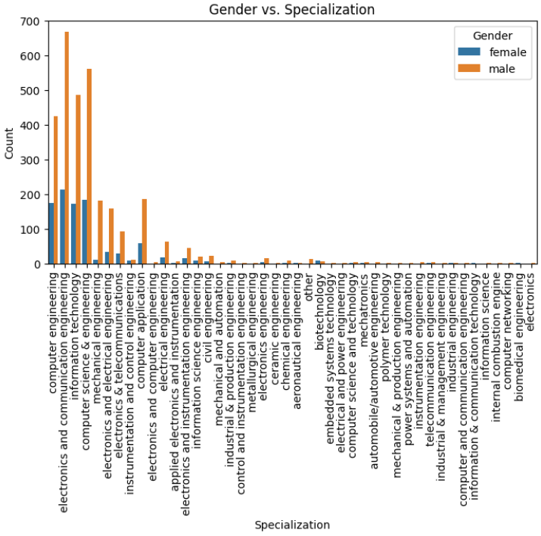
This implies that males tend to choose electronic and communication engineering more often than females do.
Conversely, other specializations, such as biotechnology, show a higher count of females compared to males.

Slide 9
Conclusion:
The project provided a comprehensive analysis of the employment outcomes for engineering graduates.
Through thorough EDA, we identified key factors influencing salary, including academic performance and specialization.
Numerical and categorical variables were explored in-depth to reveal correlations, trends, and disparities across gender and fields of study.
These insights can guide stakeholders in optimizing recruitment strategies and educational initiatives for engineering graduates, aligning skills with market demands.
Experience/Challenges working on AMCAT Data Analysis Project:
Throughout the project, we encountered challenges such as handling missing data, dealing with outliers, and ensuring the accuracy and reliability of the analysis.
Despite these challenges, the project provided valuable learning experiences and insights into the employment outcomes of engineering graduates.

Slide 10

THANK YOU

